Slide 1
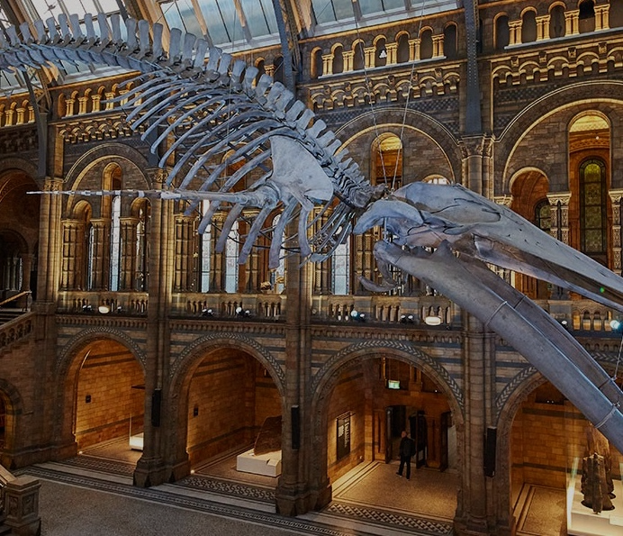




STEAM Education: Whale skeleton specimen preparation STEAM教學: 制作鯨魚骨骼標本
Dr. Scott Y.S. Chui^{a,b} (scottchui@ln.edu.hk)
Dr. Y.-W. Ho^{b,c} (yuenwa.ho@polyu.edu.hk)
Dr. Stephen C.Y. Chan^{b} (scychan@cetacea-institute.org)
ª Science Unit, Lingnaa University
^{b} Cetacea Research Institute
^{c} Department of Food Science and Nutrition, The Hong Kong Polytechnic University

Slide 2
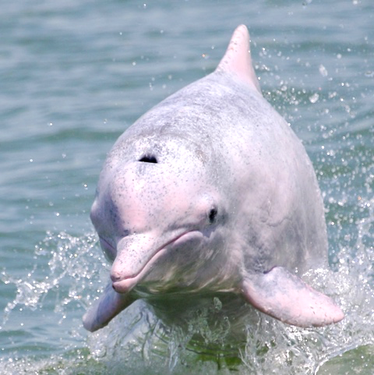
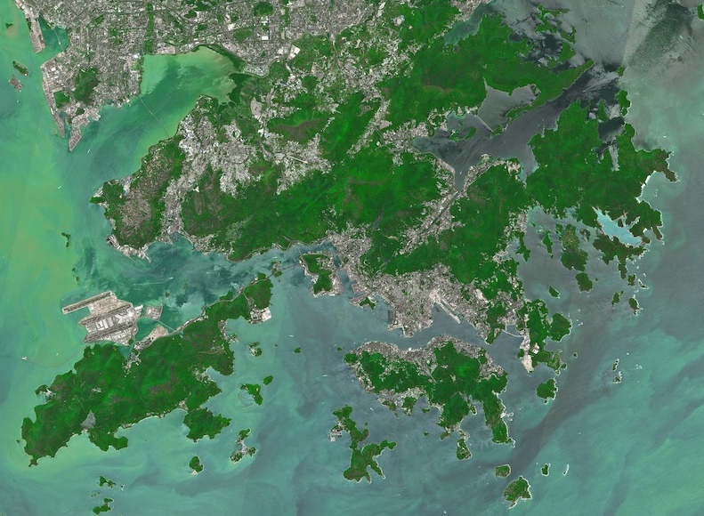
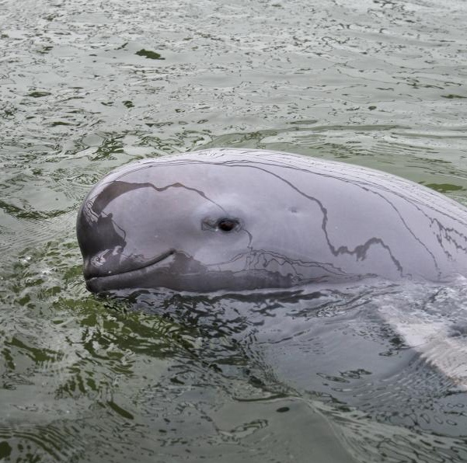
Cetacea in Hong Kong
2 cetacean species:
Chinese white dolphin 中華白海豚 (Sousa chinensis)
Western, south-western waters
Fineless porpoise 江豚 (Neophocaena phocaenoides)
Southern, eastern waters
Ocassionally visited by non-residential species

Slide 3
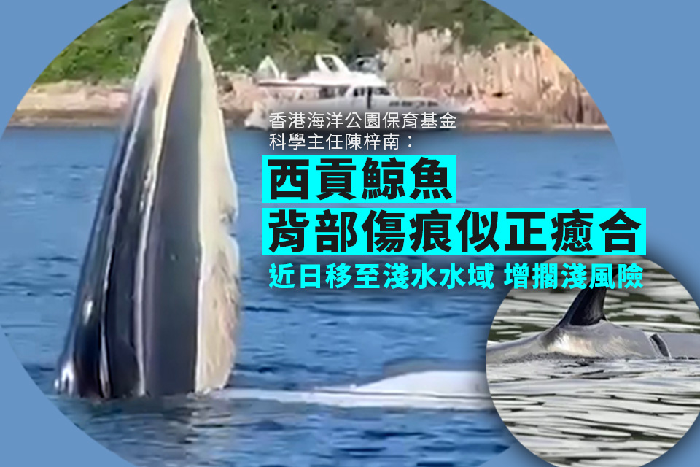
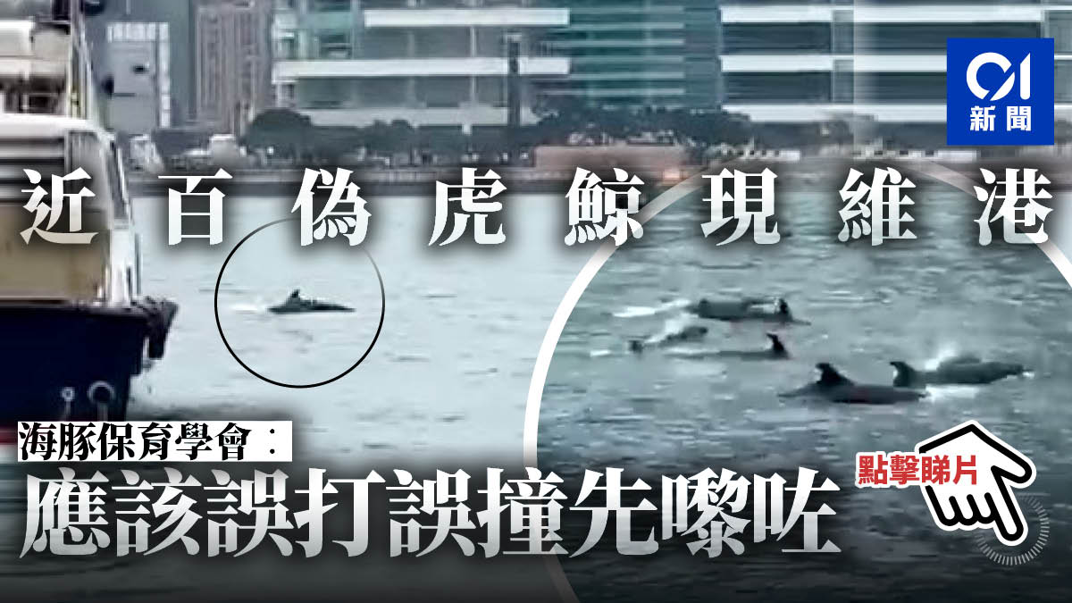
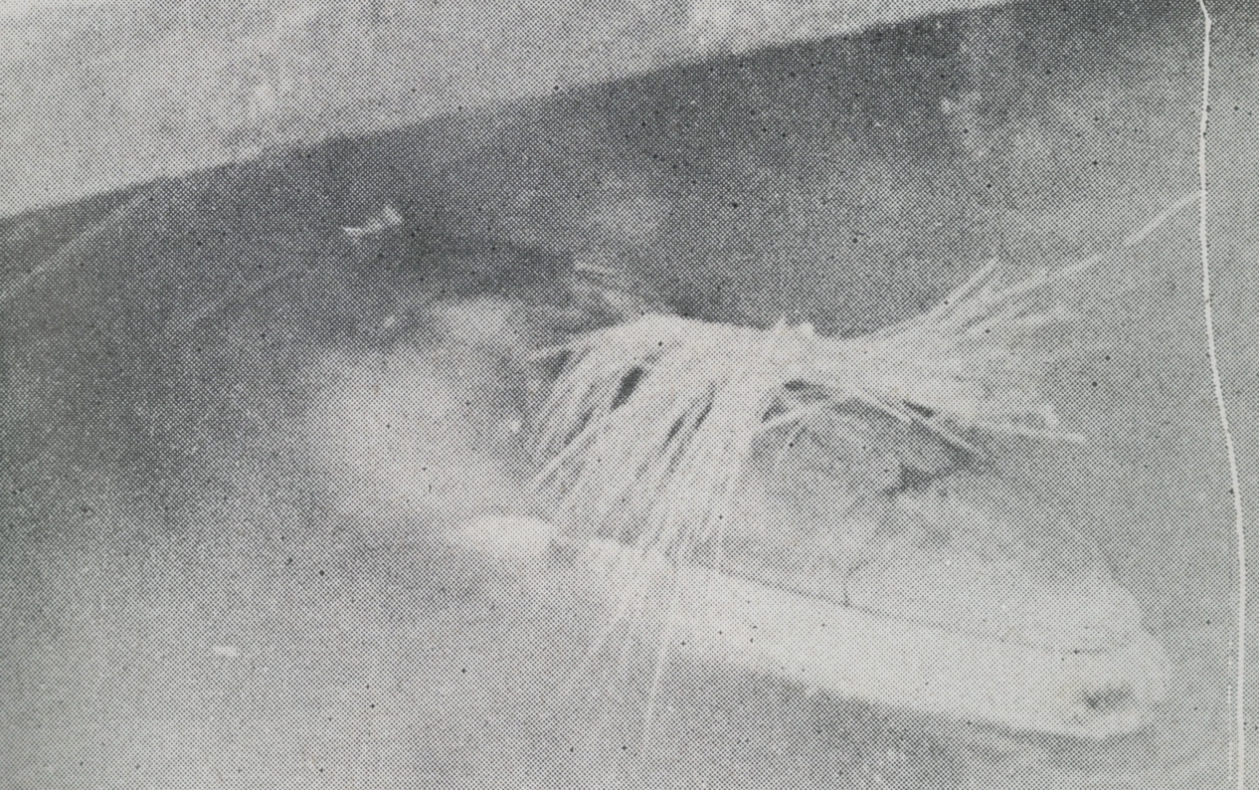
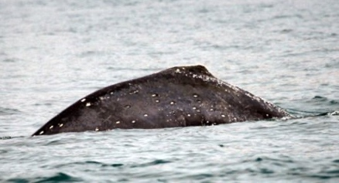
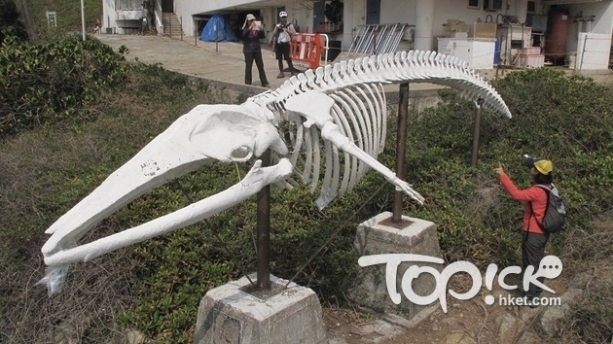
False killer whale 偽虎鯨 (Jan 2022)
Bryde’s whale 布氏鯨 (Jul 2023)
Humpback whale 座頭鯨 (Mar 2009)
Fin whale 長鬚鯨 (Apr 1955)

Slide 4
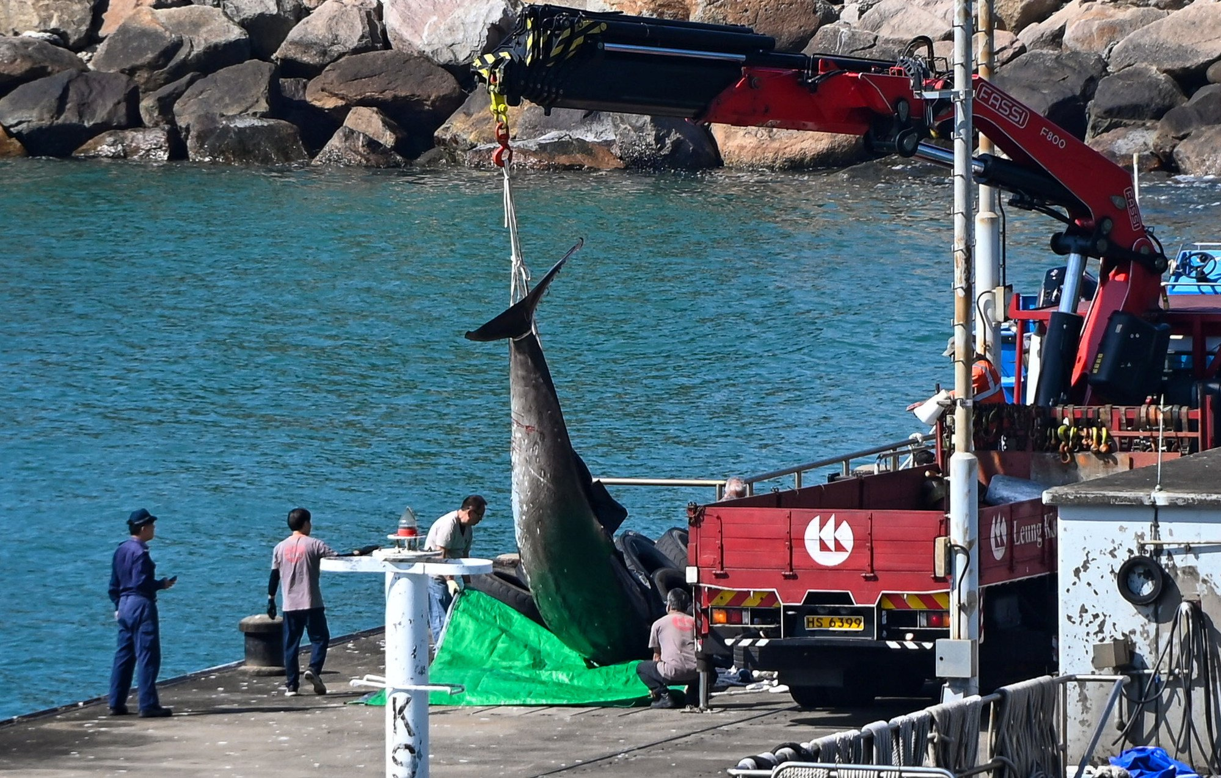
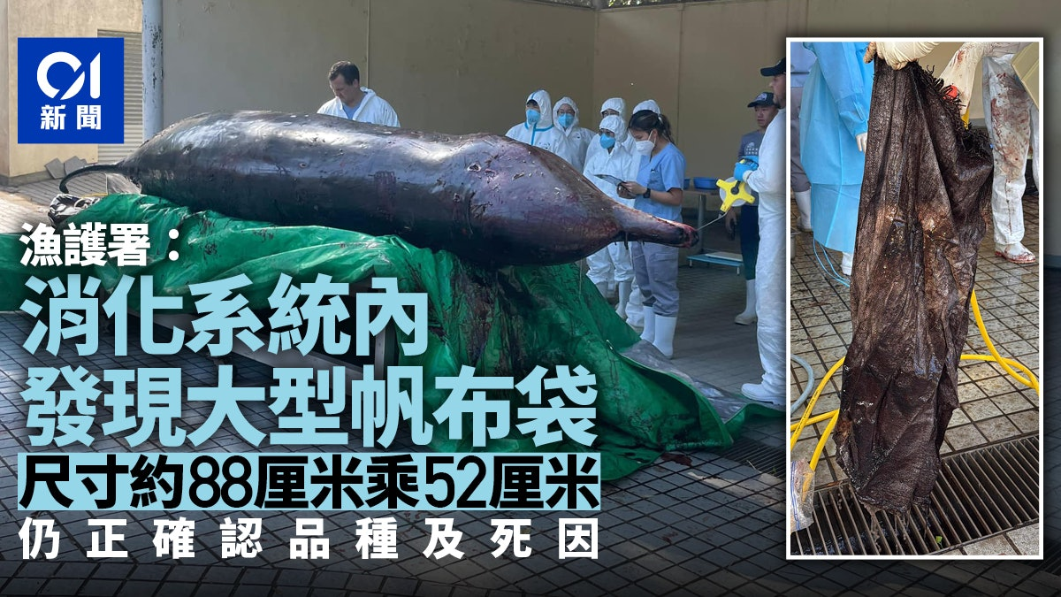
Catacea Stranding
30-Nov 2024
5.6 m long male beaked whale was spotted at Tai O coastal waters, and stranded at night
Died during vet assessment
An 88x52 cm canvas bag was found in its digestive system during necropsy
Likely the cause of its poor body condition

Slide 5
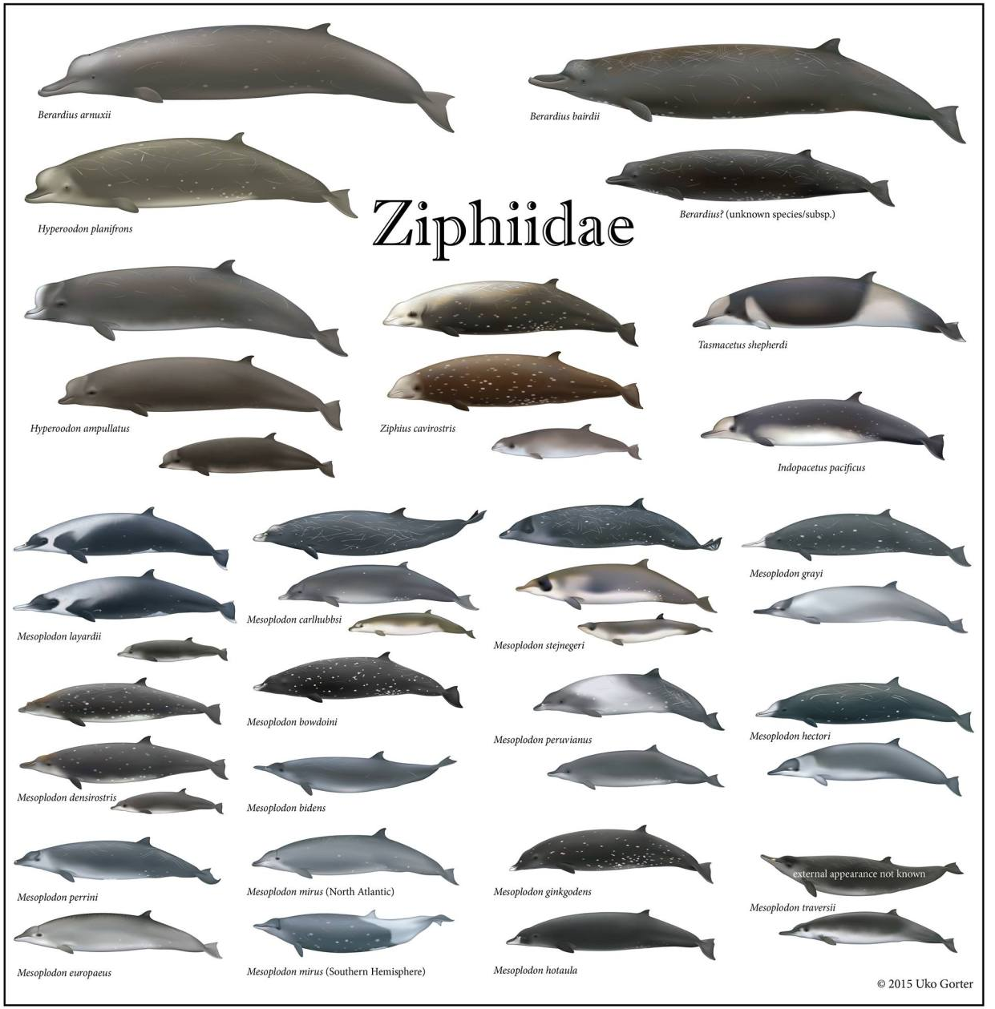
Beaked Whale 喙鯨
Ziphiidae 喙鯨科
24 species, 6 genera
Longman’s beaked bhale 朗氏喙鯨 (?) (Indopacetus pacificus) a.k.a. Indo-Pacific beaked whale
Discovered in 1882
17 stranding cases with 24 animals (2021)
Less than 10 full skeleton specimens worldwide
Notes:
I couldn’t have a confirmed no. of full skeleton specimen, but it should be less than 10 worldwide (?)

Slide 6
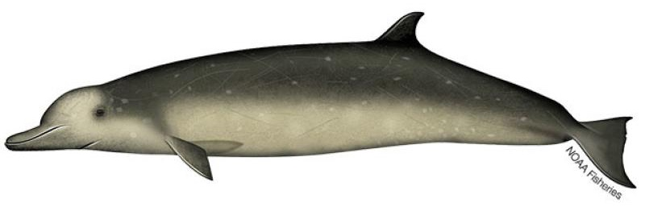
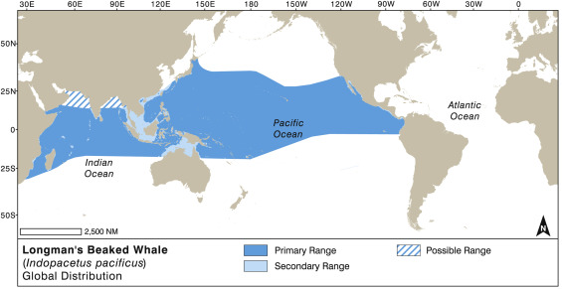
Longman’s Beaked Whale 朗氏喙鯨
6 – 8 m long
Inhabit deep ocean (~2,000 m) in tropical and subtropical regions
Found in Indian and Pacific Oceans
Group-living animal: 10-20 individuals
Feed on cephalopods (e.g., squids)

Slide 7
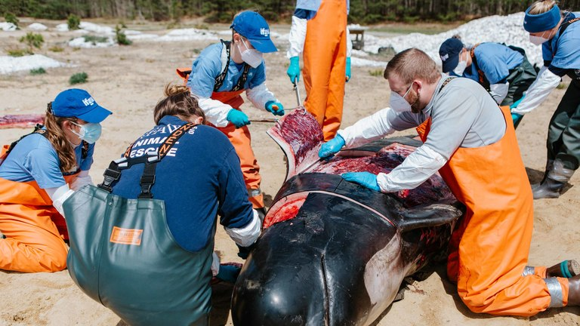
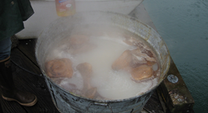
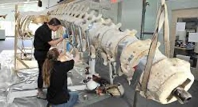
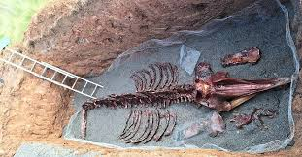
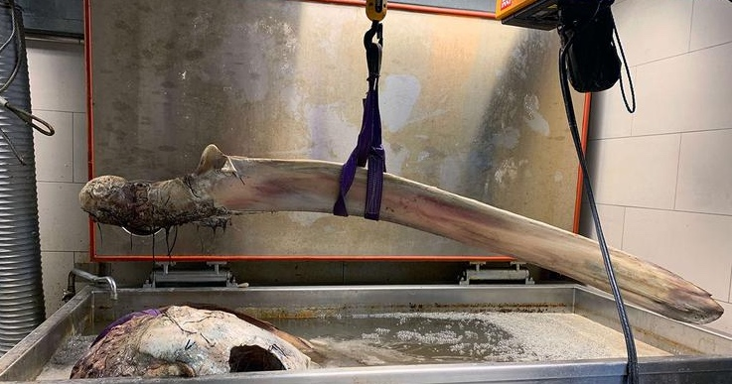
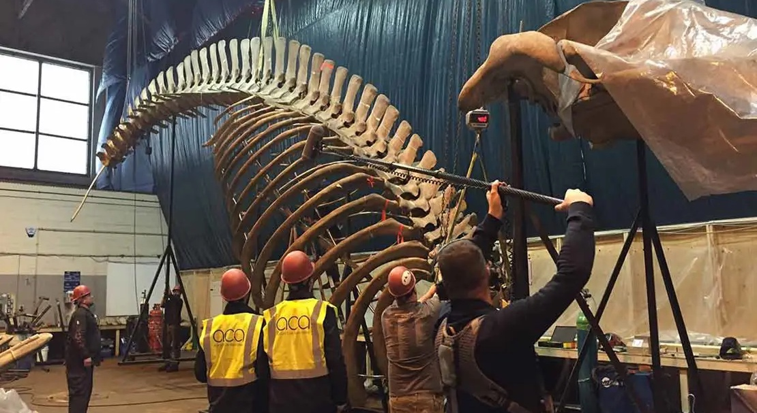
Skeleton Specimen Preparation
De-fleshing
Degreasing
Repair & Assembly

Slide 8
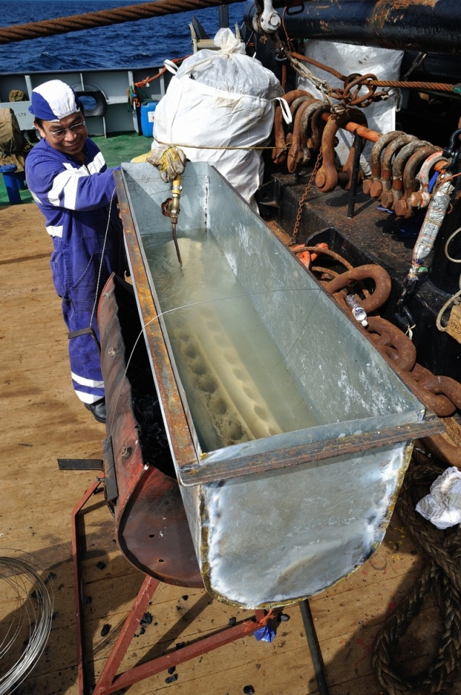
De-fleshing: Physical methods
Surgical removal
Boiling

Slide 9
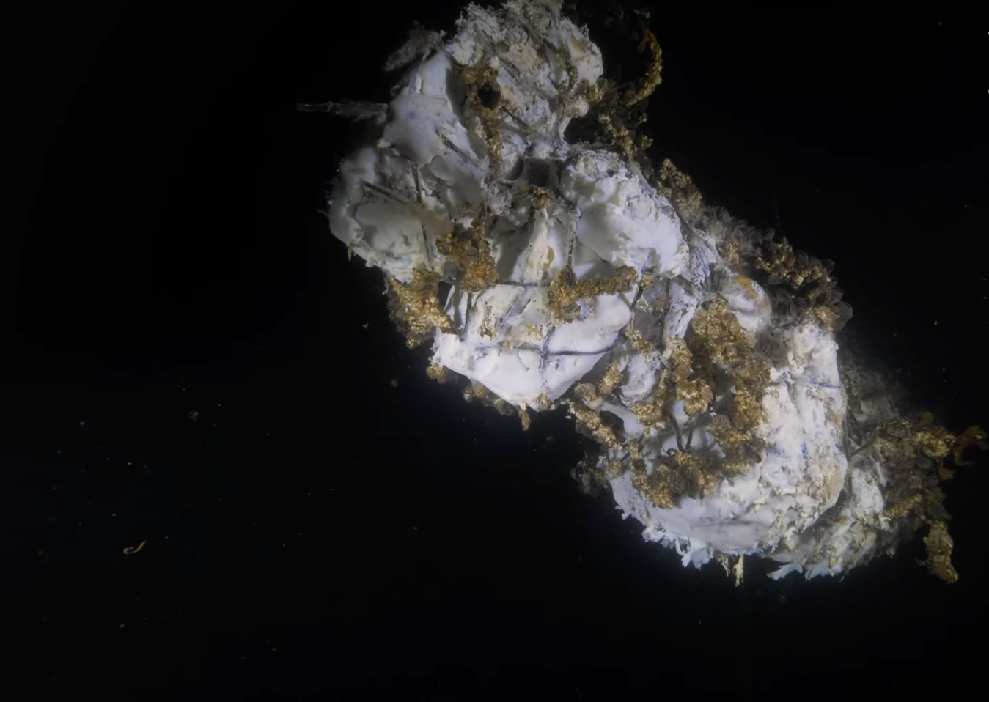
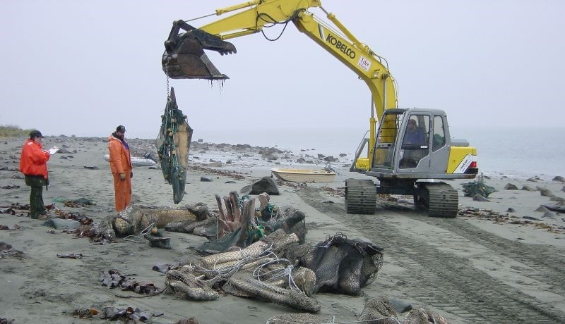
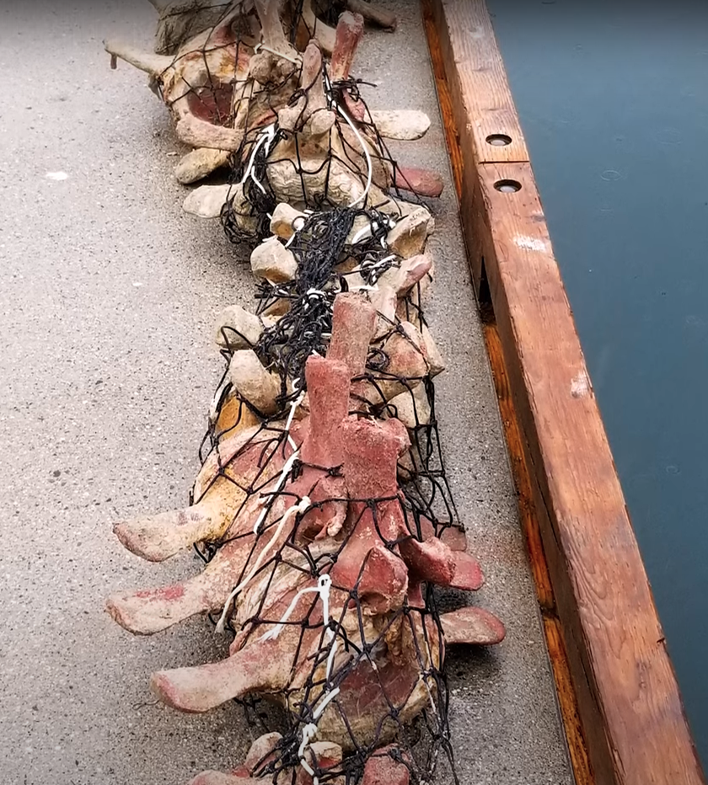
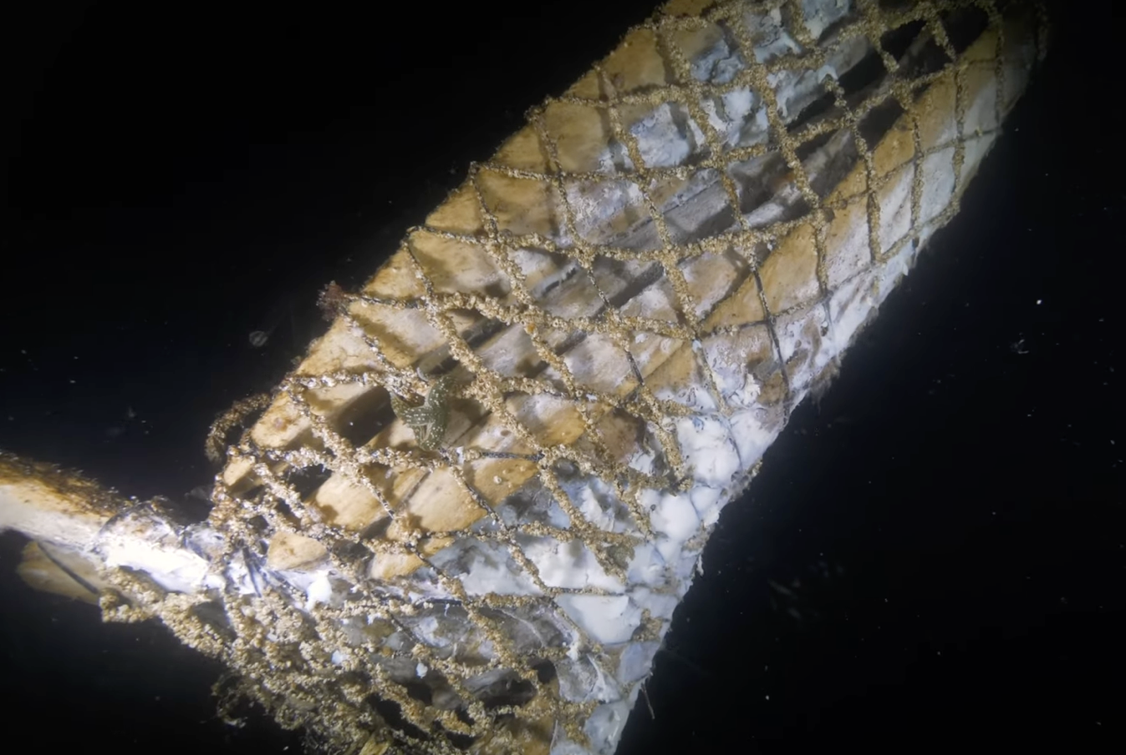
De-fleshing: Biological methods
Months – Years
Natural decomposition

Slide 10
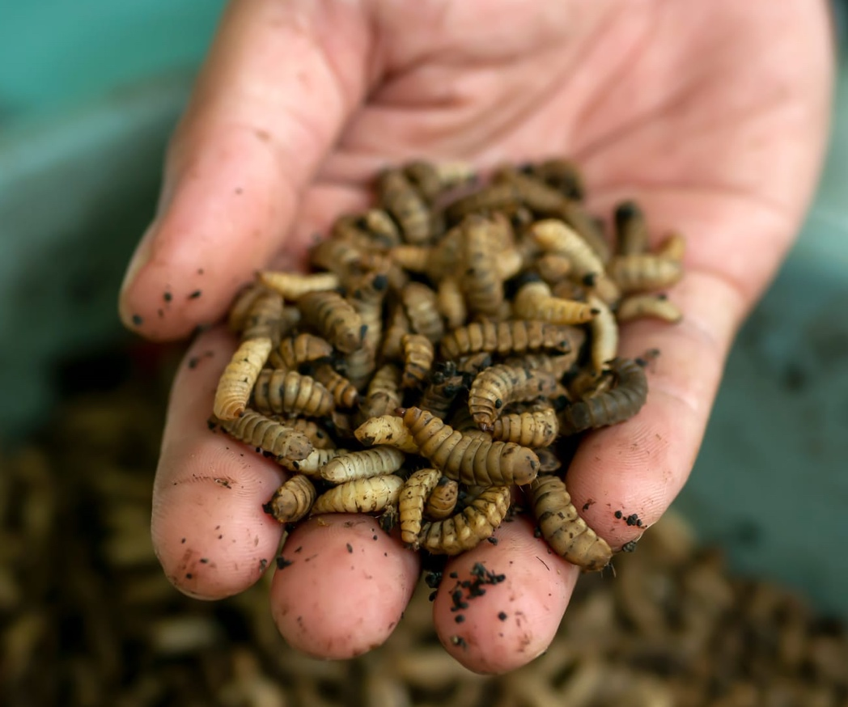
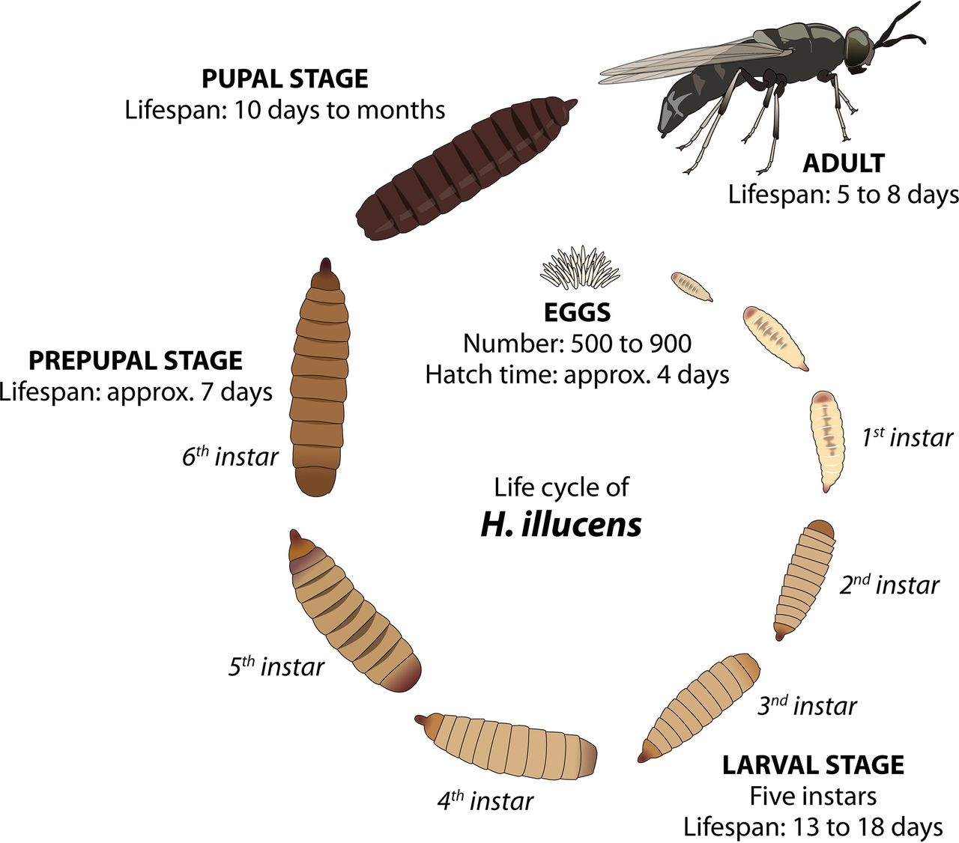
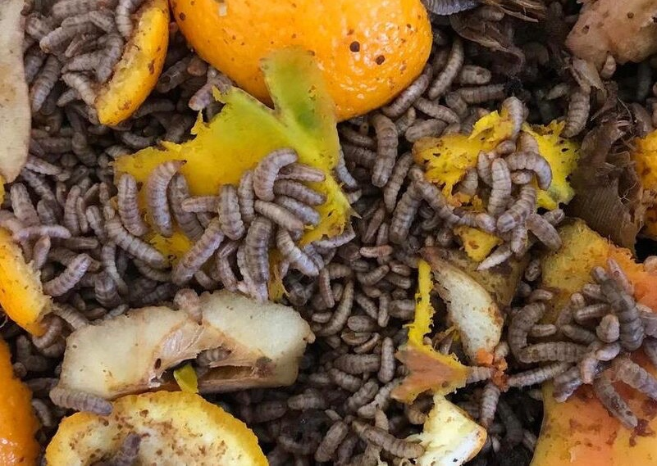
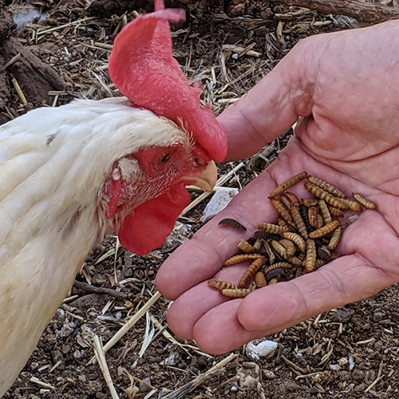
De-fleshing: Biological methods
Black soldier fly (Hermetia illucens) larvae 黑水虻幼蟲
Powerful digestive enzyme allows them to consume large amount of organic materials
Often used in food waste treatment

Slide 11
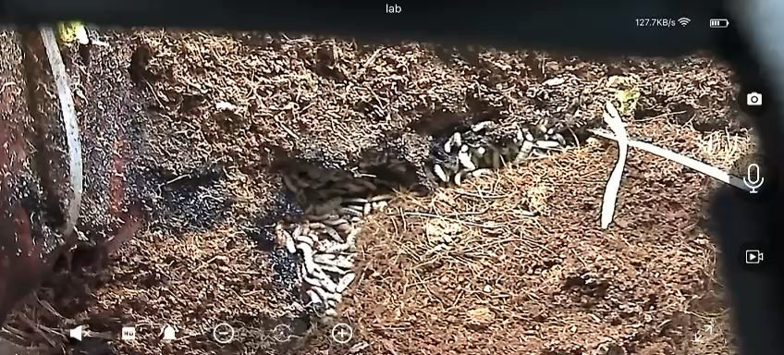

Slide 12
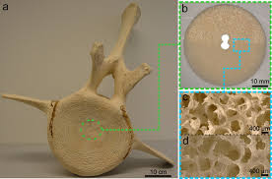
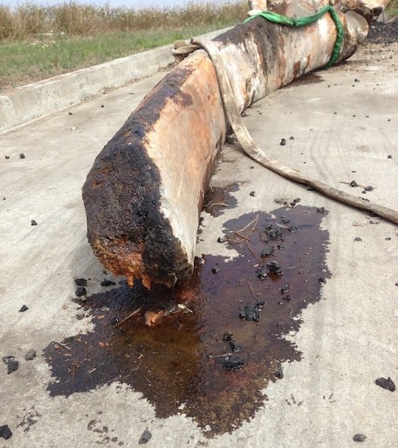
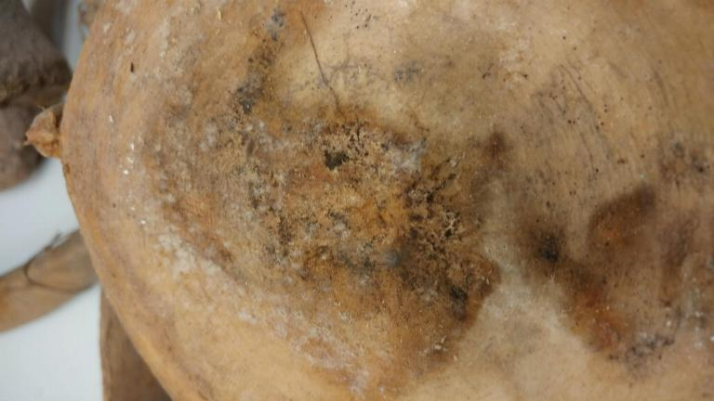
Degreasing
Cetacean bones are porous and high in fat content
In left untreated, fat and blood in bone will decompose, turning the specimen smelly and mouldy

Slide 13
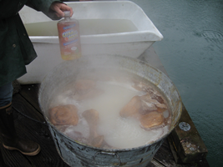
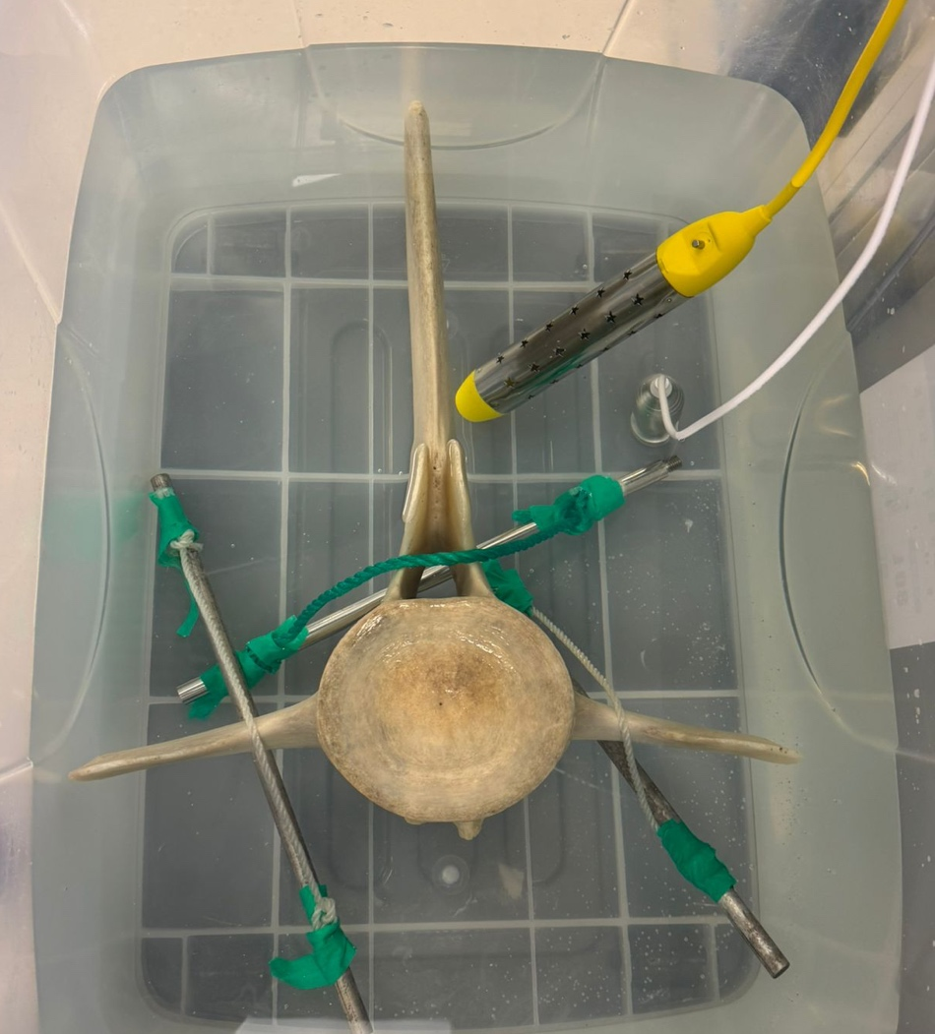
Degreasing
Boiling the bones, sometimes with degreaser added, to remove fat & blood content
* Over-processing may damage the bones
Soaking the bones in detergents & chemical to passively remove fat & blood
Water bath heater (~40 °C) & sonicator can help speed up the process
* Safe, easy & budget procedure, suits for STEAM education & student participation

Slide 14
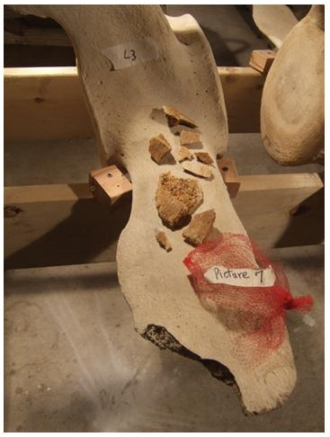
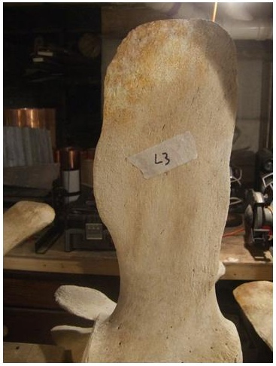
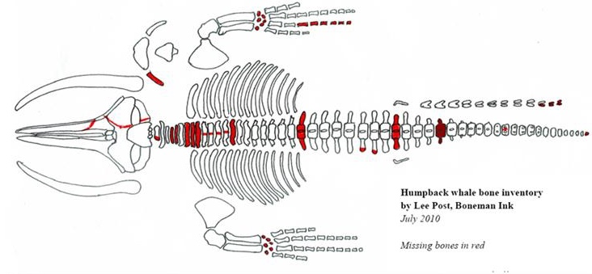
Repair & Assembly
Identify & replace missing parts
Repair broken parts

Slide 15
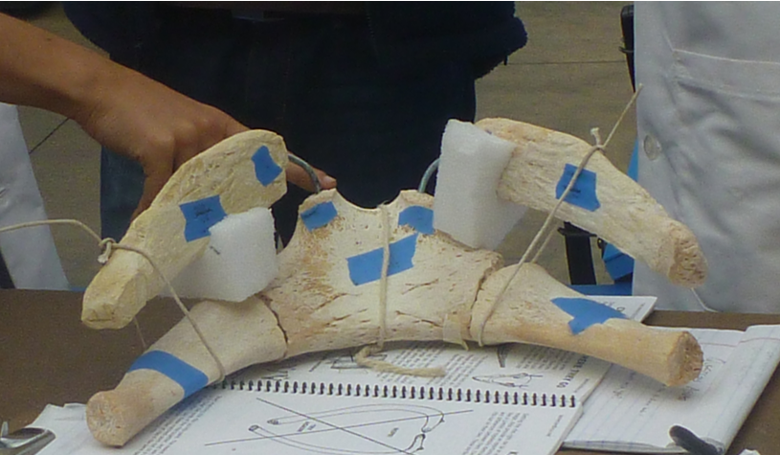
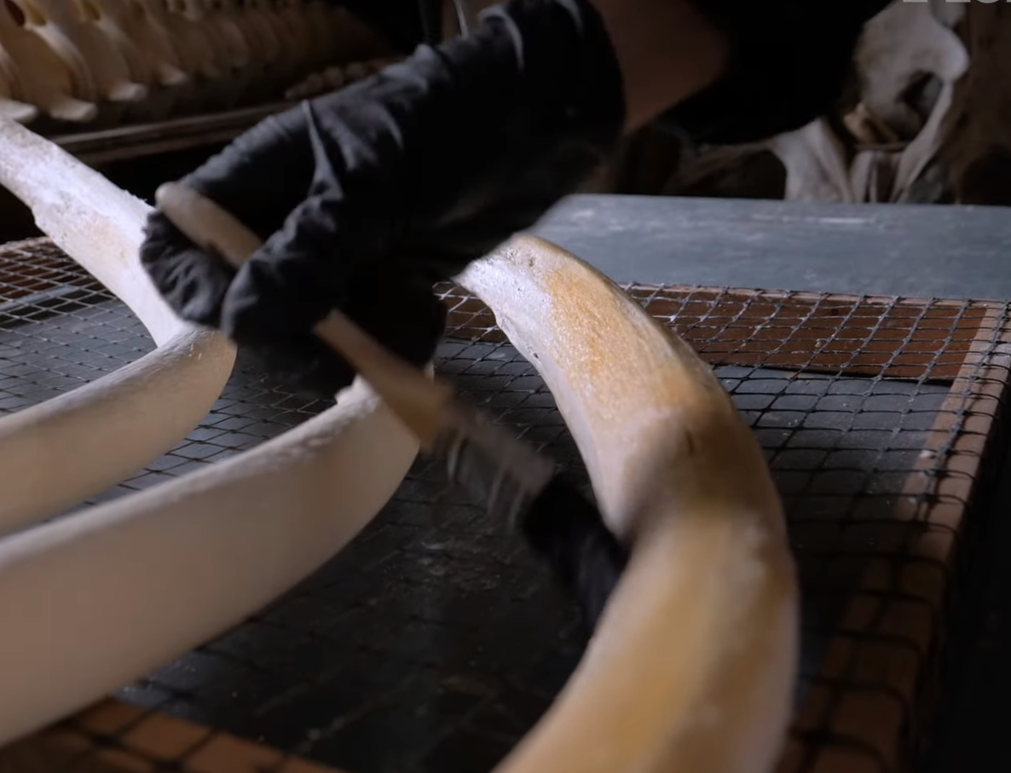
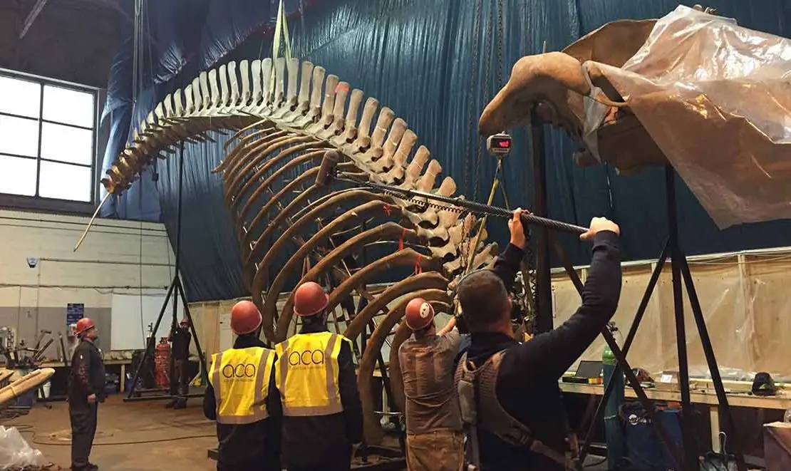
Repair & Assembly
Assembly & Display
Protective coating

Slide 16
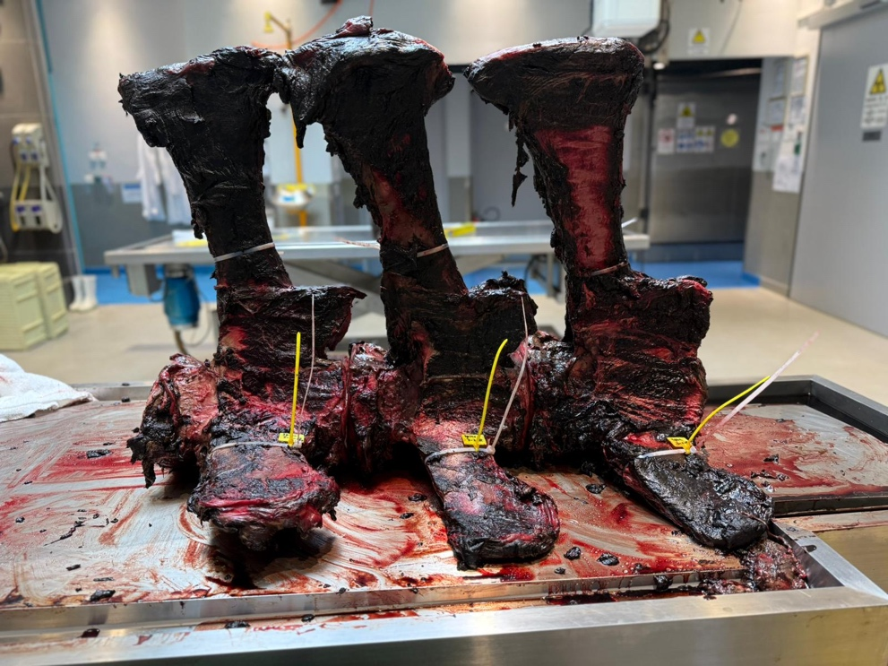
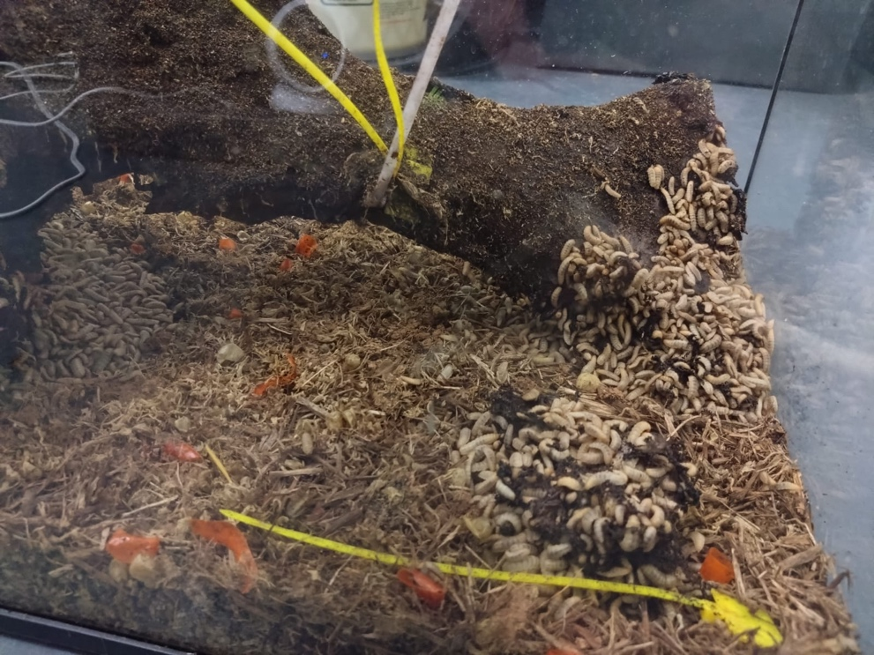
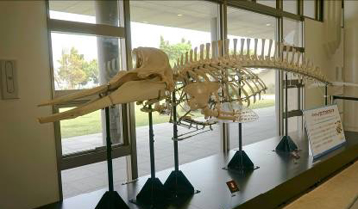
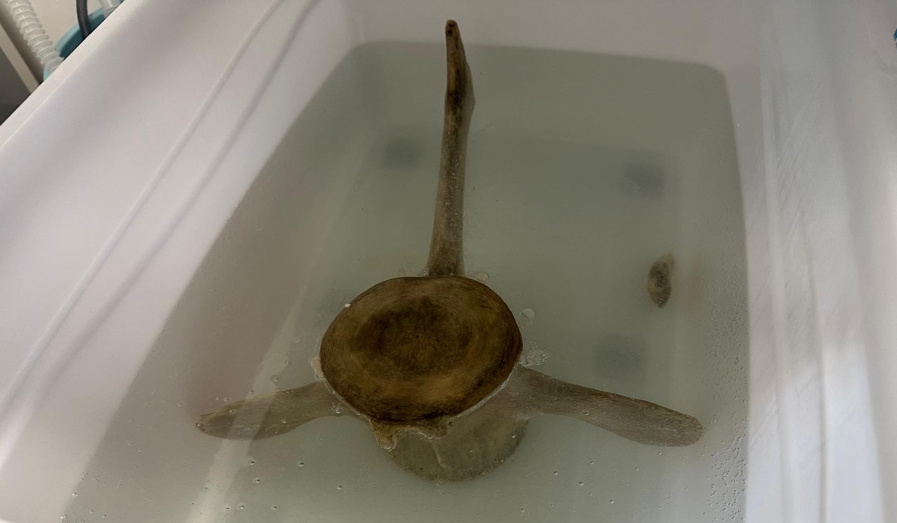
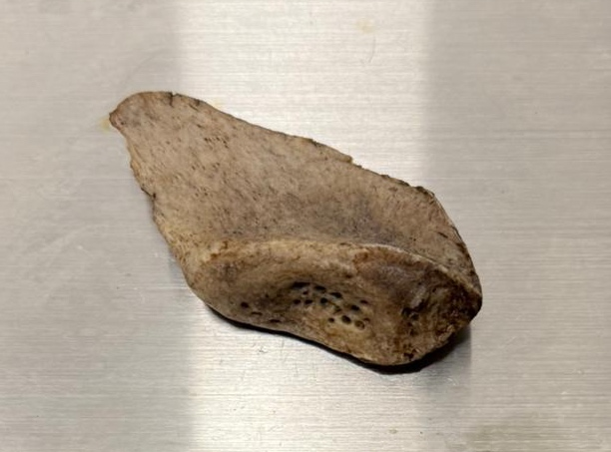
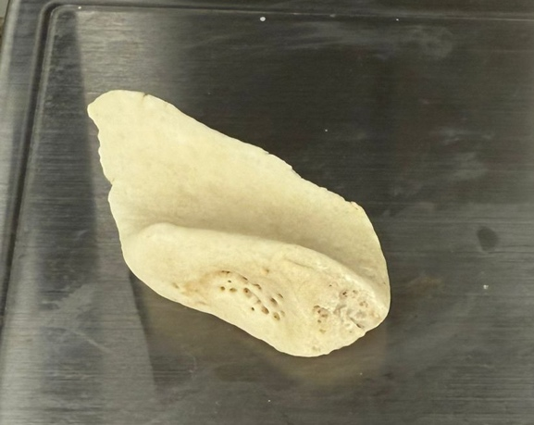
De-fleshing (~2 months)
Repair & Assembly (~6 months)
Mar 2025
Jun/Sep 2025
Jun/Sep 2026
Degreasing (~12 months)

Slide 17
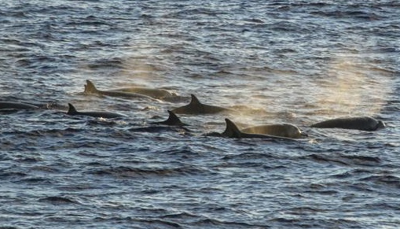
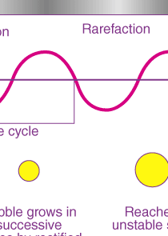
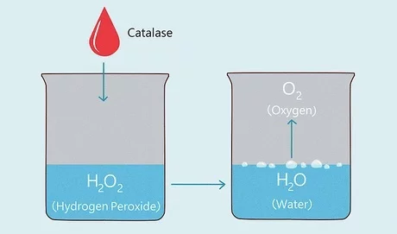

STEAM Education Program
Rare & unique experience of skeleton specimen preparation
Multidisciplinary project involving biology, ecology, chemistry, physics, and environment science
Student ambassador for public education and exhibitions

Slide 18

STEAM Education Program
* Male Longman’s Beaked Whale skeleton in Okinawan
Skull
Vertebrae
Flippers
Ribs
Skull: ? x ? x ? m x1
Vertebrae: ? x ? x ? m (max) x 30
Ribs: ? x ? x ? m (max) x 20
Flippers: ? x ? x ? m x 2
Notes:
Just need a rough measurement

Slide 19
STEAM Education Program
Recruit at least 2 student helpers (recommend 4 or more) to participate in the de-greasing process (~12 months)
Each school will help process 3-5 containers of sample, depending on the no. of participating schools and capacity
Vertebrae + ribs
Follow degreasing procedure, report regularly the progress (upload photographic records of the sample for monitoring)
Student ambassadors (post-specimen preparation)
Introduce specimen preparation to public
Promote environmental protection, wildlife & marine conservation
Notes:
We can ask the student to take pictures of the bones with a colour scale card and upload the pictures to a Google drive folder, so we can keep monitoring the progress without physically visiting the school every week.

Slide 20

Degreasing Procedure
Before
After
Estimated a 12-month process
Remove all fat and oil content from the bones for long-term storage & display
Equipment | Consumables | Safety gears
Plastic container | Washing powder | Gloves
Siphon pump | Hydrogen peroxide | Safety goggles
Sonicator | Cable ties/robe | Lab coats
Water bath heater | Air freshener (optional)
Colour scale card
Notes:
Any other equipment/consumables that you can think of?
Will also need to hear feed back from school what equipment they are comfortable purchasing

Slide 21


Water bath heater at 40°C
A picture changing solution with the pump
Sonicator
Weight attached to bone by cable ties/robe
A picture of the bone with a colour scale card

Slide 22

Soaking solutions
Washing powder solution
60L of water + Xg of washing powder
For extracting fat content
1% H₂O₂ solution
60L of water + 600ml of 30% hydrogen peroxide
For breaking down blood stain
A picture of whichever brand of washing powder we want to use
Notes:
I think we should standardise which brand of washing powder to use

Slide 23

Drain soaking solution with siphon pump
Add new soaking solution* into the container
Turn on sonicator & water bath heater (40°C)
Leave the bones in solution for X days#
Take photographic records of the bones
* Washing powder solution or 1% H₂O₂ solution depending on the stage of procedure
# No. of days depends on the stage of procedure
Notes:
1% peroxide solution seems to be working fine so far
We also need to set a standard concentration for the washing powder solution

Slide 24
Degreasing Procedure
Stage | Timeline | Treatment | Frequency | Start date
#1 | 1st month | Soak samples in alternating solutions: 2-day washing powder solution 2-day 1% H₂O₂ solution | Alternate soaking solution once every 2 days | Jun 2025 (Sep 2025)
#2 | 2nd month | Soak samples in washing powder solution | Once a week | Jul 2025 (Oct 2025)
#3 | 3rd – 6th month | Soak samples in washing powder solution | Once every 2 weeks | Aug 2025 (Nov 2025)
#4 | 7th month onward | Soak samples in washing powder solution | Once a month | Jan 2026 (Mar 2026)
#5 | Final week | Air-dry samples for 3-4 days | -- | May 2026 (Aug 2026)
Notes:
Just a tentative schedule, will need to hear from schools how do they feel about the timeline & starting date

Slide 25


Post-specimen preparation: Education & Exhibition
Cleaned bones will be scanned to create a 3D computer model
Full skeleton will be displayed in public
Tentative exhibition venues:
Tai O (long-term)
Malls & public venues (short-term)
Full-size/scaled replicates can be 3D-printed for education/exhibitions
Student ambassadors of wildlife & marine conservation

